Slide 1


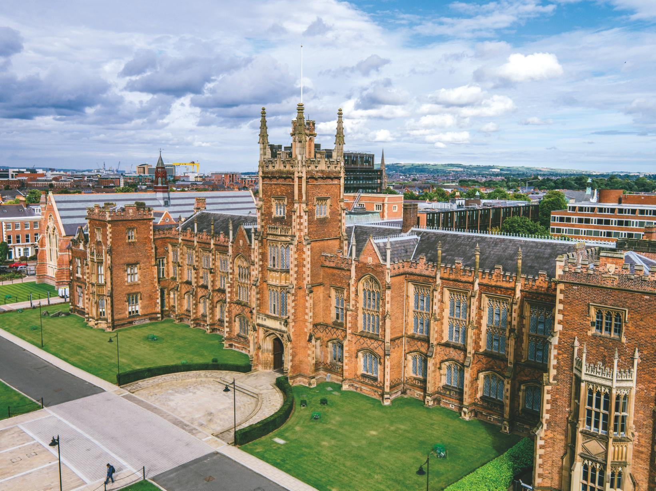
PATHWAY OPPORTUNITY PROGRAMME
2026 programme
Notes:
We’re here to talk about the Pathway Opportunity Programme for 2025
1

Slide 2

Are you interested in studying at Queen’s University?
Are you in the first year of your A-Level course or other Level 3 programme?
Would you like to receive tailored support and encouragement to get to Queen’s?
Then the Pathway Opportunity Programme could be for you!
Notes:
Would like to study at Queen’s / consider Queens to be high up in their options
Are in their first year of a 2 year Level 3 Programme like A-Levels or BTEC
And could use a bit of extra encouragement and support to get to Queen’s
Then The Pathway Opportunity Programme could be for you
2

Slide 3

STATISTICS SHOW UNDERREPRESENTATION IN HIGHER EDUCATION…..
  Parents did not attend university
  Low-income households
  Certain neighbourhoods
  Carers
  Care Leavers
  Refugees/Asylum Seekers/Newcomers
Notes:
Because …… Statistics show that we have lower participation from students…
Whose parents did not attend university
From low income households
From certain neighbourhoods that don’t traditionally have students going to university
Who are young carers – for a child or an elderly parent or grandparent
Who are care experienced – either Foster Care or Residential Care
Who are refugees/Asylum Seekers/Newcomers
Queen’s works to widen participation for these groups – and the Pathway Programme is one way they do that.
4

Slide 4
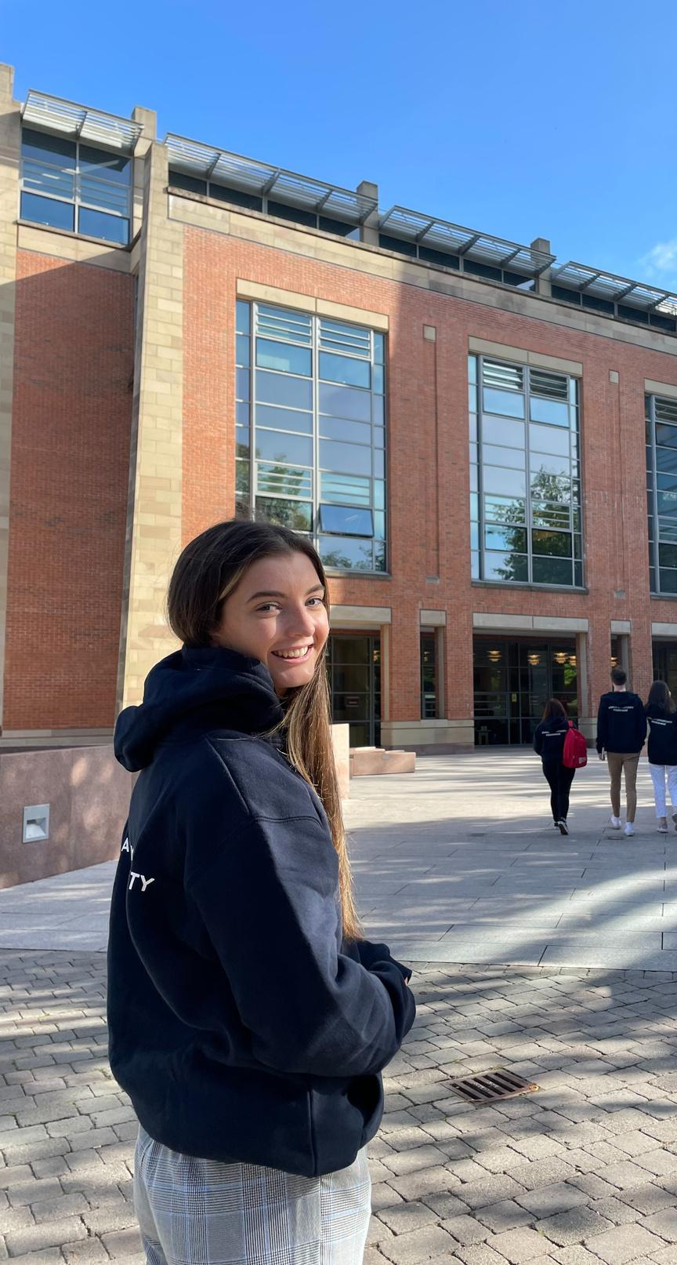

WHAT IS THE PATHWAY OPPORTUNITY PROGRAMME?
Who?
  For Year 13 pupils/first year student of Level 3 qualification underrepresented in higher education to support progression to Queen’s.
When?
  Delivered as a series of in-person and online events between January and November during the school day – plus a one week summer school on Queen’s campus.
Why?
  Builds skills, knowledge and confidence to access, study, experience and progress to University, and specifically Queen’s.

Slide 5

WHAT ARE THE BENEFITS?
  Guaranteed Conditional Offer / Guaranteed Interview
  Up to a 2 grade reduction on A Level entry requirements *
  £1000 Kilwaughter Minerals Bursary
  UCAS advice from Queen’s admissions experts
  Learn from university academics, experience university life, make connections to services at Queen’s
  Feel more confident and prepared for the transition to life and study in higher education.
  ‘Once a Pathway Student Always a Pathway Student’
* Depending on programme assessment and Pathway
Notes:
Benefits:
All participants who complete the programme receive a guaranteed conditional offer of a place at Queen’s University within your Pathway subject, or a guaranteed interview for courses that have interviews (Medicine, Dentistry, Pharmacy, Social Work and Nursing & Midwifery)
Be eligible for an offer reduced by up to two A-Level grades (depending on performance and course applied for). Explain that a 2 grade reduction will take a standard offer for Law of AAA down to ABB and will take a standard offer of ABB for History down to BBC.
Receive a £1000 support bursary upon 1st year entry at Queen’s – provided by Kilwaughter Minerals, a major supporter of the Pathway programme since it started in 2017
Receive UCAS Application Advice – you’ll hear from the lady at Queen’s who reads your UCAS applications
Experience a bit of University Life
Receive support upon arriving at Queen’s from the POP TEAM and the other services at Queens you will be connected with on the programme. This will help you get settled in when you arrive. The POP team will be be there to support you, as Pathway Students, through their time at Queen’s
6

Slide 6
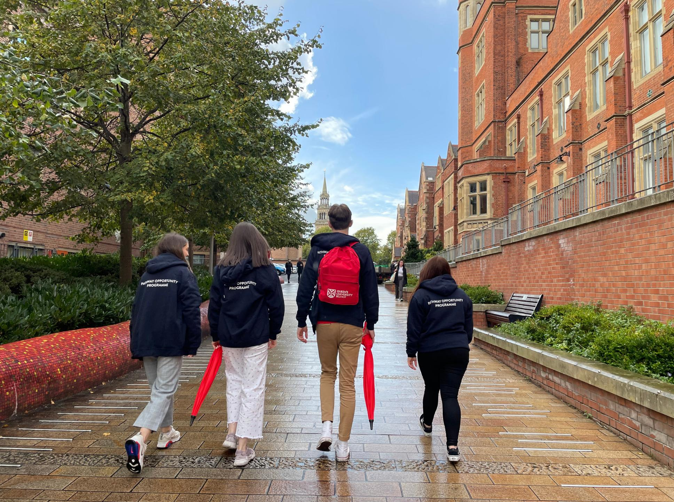
WHAT PATHWAYS CAN I CHOOSE?
Arts, Humanities and Social Sciences (AHSS)
Biological Sciences
Business
Computer Science
Engineering
Law
Mathematics, Physics and Chemistry (MPC)
Medicine, Dentistry and Biomedical Sciences (MDBS)
Natural and Built Environment (NBE)
Nursing
Pharmacy
Psychology
Social Work
Arts, Humanities and Social Sciences (AHSS)
Mathematics, Physics and Chemistry (MPC)
Medicine, Dentistry and Biomedical Sciences (MDBS)

Slide 7


THINKING AHEAD...
Every course at Queen’s has a different set of entry requirements.
See what courses within your pathway are available for you to study at Queen’s by checking their entry requirements online.

Slide 8


WHAT DOES THE YEAR LOOK LIKE?
Apply (29ᵗʰ September - 3ʳᵈ November 2025)
Welcome & Orientation – January 2026
Subject Skills Session – February 2026 (Online: self-paced)
Academic Skills Session – March 2026
Subject Specific Session – April 2026
University Information Session – June 2026
Summer School – Last week June & first week of July
Next Steps Session – September 2026
Celebration Event – End November 2026
Notes:
“So what is the path?”
Each box comes up with a click to talk the students through the steps:
Apply by 3rd November (applications open on 29th September)
Welcome event on campus in January and a first chance to meet the academics and lecturers from their Pathway subject
Online subject skills sessions (specific to their pathway) on the VLE over the February mid-term break to get them started in their subject – 4-5 hours work online
Back to campus in March for Academic Skills such as study skills and exam preparation
A day on campus in April to work with their subject academics – learning in the subject schools at QUB.
Then after they’ve done their AS exams, another day on campus in June for the University Information Session to learn more about University; admissions, finance and accommodation, but also to get ready for the summer residential…
Week-long on campus residential summer school in either June or July (depending on their Pathway) where they work in their subjects and complete an academic assessment
Return in September for an on campus Next Steps session to focus on their next steps with their UCAS application, and get connected to the range of support services at Queens
Finish off in November/December 2025 with an on campus Celebration event where you come down on a Saturday with your family for a graduation of sorts to celebrate completing the programme
9

Slide 9



THE PATHWAY
SUMMER SCHOOL
Notes:
10

Slide 10

THE SUMMER SCHOOL RESIDENTIAL
  Last week of June or first week of July (Pathway dependent).
  Monday to Friday.
  Experience studying like an undergraduate by staying in a private en-suite room in Queen’s Elms.
  Experience lectures, labs, and hands-on workshops from your subject’s top academics.
  Work on group projects, attend team outings and get to know university campus better.
  Complete end of residential assessment.
Notes:
Describe the residential.
In either the last week of June or the first week of July – depending on your Pathway
You arrive on Monday morning and finish on the Friday after you complete your assessment. Experience learning in lecture halls, laboratories, mock courtrooms and completing field trips. Evenings include free time in Elms Village, off site activities and breakfast lunch and dinner is included for the week.
You will meet your fellow Pathway students, experience studying like an undergraduate, attend lectures from top academics and work on group projects with current undergraduate student assistants.
The Assessment will look different for each pathway – some complete a project and deliver a presentation, some sit a short test, some complete group work etc. Marks and grade reduction offers are sent out start of September.
11

Slide 11


WHAT IS REQUIRED TO SUCCESSFULLY COMPLETE THE PROGRAMME?
Attend all events – 6 x 1 Day Events.
Complete all Online coursework.
Complete the Residential Summer School and final assessment.
Notes:
Read slide
12

Slide 12
ELIGIBILITY REQUIREMENTS
Section A Criteria
You must meet all of the following:
  You must be ordinarily resident in Northern Ireland and be in full-time attendance at a school or college in Northern Ireland.
  You must currently be in year 1 of an acceptable (to the University) two-year Level 3 qualification such as A-Levels, BTEC etc.
  Neither of your parents have attended university nor obtained an undergraduate degree (or equivalent) in the UK, Ireland or abroad.
  You must have at least 6 GCSEs (or equivalent) at grades A*-C, including English Language, of which 5 must be at grade B or above.
Notes:
What is required to be eligible to apply?
13

Slide 13
Acceptable Level 3 Qualifications
A-Level
A-Level
A-Level
BTEC Extended Diploma
(Triple Award)
A-Level
A-Level
BTEC Subsidiary Diploma
(or other single award)
BTEC Diploma
(Double Award)
A-Level
BTEC Diploma
(Double Award)
BTEC Subsidiary Diploma
(or other single award)
Notes:
What level 3 qualifications are acceptable to Queen’s?
Three A Levels are fully acceptable
Click
And two A-Levels and one BTEC Subsidiary Diploma or other Single Award qualification like OCR’s are acceptable.
And at the other end of the spectrum a BTEC Extended diploma worth 3 A-levels is acceptable – but is generally only taught at regional colleges, not at schools
And if your school does BTEC Diplomas which are worth 2 A-levels then that’s fine with an A-Level or Another single award BTEC or OCR
15

Slide 14

Not acceptable combinations
A-Level
BTEC Subsidiary Diploma
(or other single award)
BTEC Subsidiary Diploma
(or other single award)
BTEC Subsidiary Diploma
(or other single award)
BTEC Subsidiary Diploma
(or other single award)
BTEC Subsidiary Diploma
(or other single award)
Notes:
What is unfortunately not acceptable to get on the Pathway Programme nor to come to Queen’s at all is
A single A-level and TWO Single Award BTEC’s or OCRS
Or indeed three single award BTEC’s or OCR’s
16

Slide 15
Section B Criteria
You must meet ONE of the following:
  Be eligible for or are currently receiving free school meals (FSM) and/or Education Maintenance Allowance (EMA).
  Be the main carer for a family member or dependant*.
  Have a permanent residence postcode that is classified as being in a "disadvantaged neighbourhood” by the Northern Ireland Statistics and Research Agency.
  Be a Newcomer, a Refugee or an Asylum Seeker.
  If you are care experienced or currently in the care of a Health and Social Care Trust, you are automatically offered a place on the programme provided you meet Section A requirements.
On your application form please select all Section B criteria that apply to you - points for shortlisting are awarded for each criteria you meet.
Notes:
They must meet just ONE of these Section B criteria but they need to let us know all that apply to them
*definition of carer - A carer is someone who ‘cares, unpaid, for a friend or family member who due to illness, disability, a mental health problem or an addiction cannot cope without their support’ (Carers Trust, n.d). Please tell us about this on your personal statement.
For postcode say “by the Northern Ireland Statistics Research Agency” and this looks at a number of things like how close hospitals and leisure centres are to the post code, availability of buses and doctors offices as well as looking at average incomes.”
Highlight the note at the bottom to tick ALL that apply because the applications are initially shortlisted based on the different Section B categories that apply to them so the more they tick the higher they will be on the shortlist.
17

Slide 16
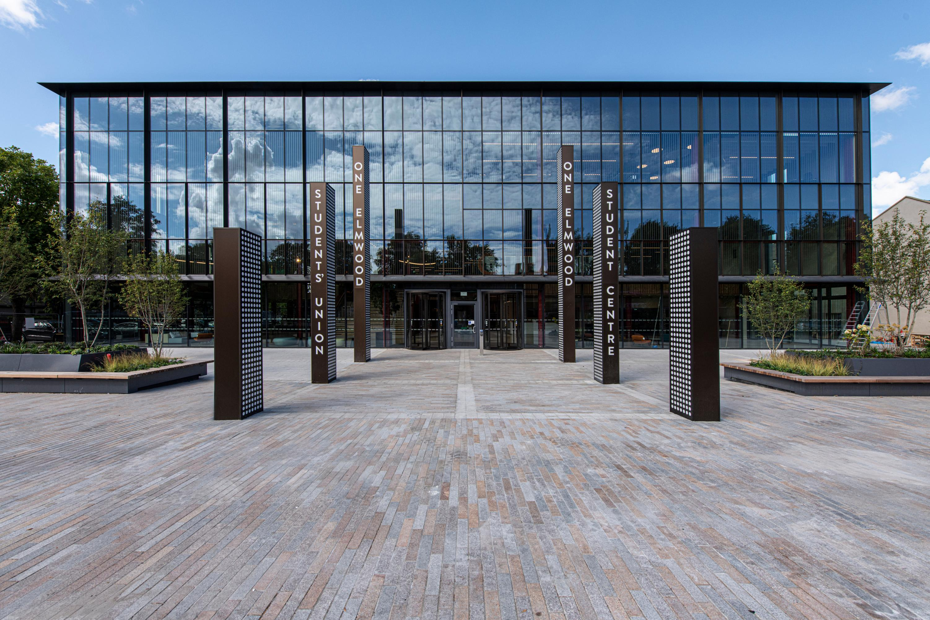
APPLICATIONS OPEN SEPTEMBER 29th 2025
We have 300 places on the programme: 20-30 places in each of the 13 Pathways
To apply:
  Visit go.QUB.ac.uk/QUBPathway
  Google “QUB POP” and click “Applications for 2026 Programme”.
APPLICATIONS CLOSE NOON NOVEMBER 4TH 2025
Notes:
So now for applying?
We expect 500 applications for 300 places so you do have a pretty good chance of getting on the programme
Go to this web site or just Google “Queen’s University Belfast Pathway Programme” – ‘Applications for the 2026 Programme’
18

Slide 17
APPLICATION INFORMATION
  The Application cannot be saved as you go along - you need to complete it in one sitting and click submit.
  Make sure to choose a First and Second choice Pathway - in case your first choice is oversubscribed
  A teacher in your school is required to complete a ‘technical reference’ to confirm your GCSE and A-Level information you submit. Take care to put in their correct email address.
  A short Personal Statement is required: 200 words on what motivated you to apply to the programme.
Notes:
Read Slide
MDBS, Law etc. Oversubscribed – Social Work, Psychology etc. Less so
21

Slide 18
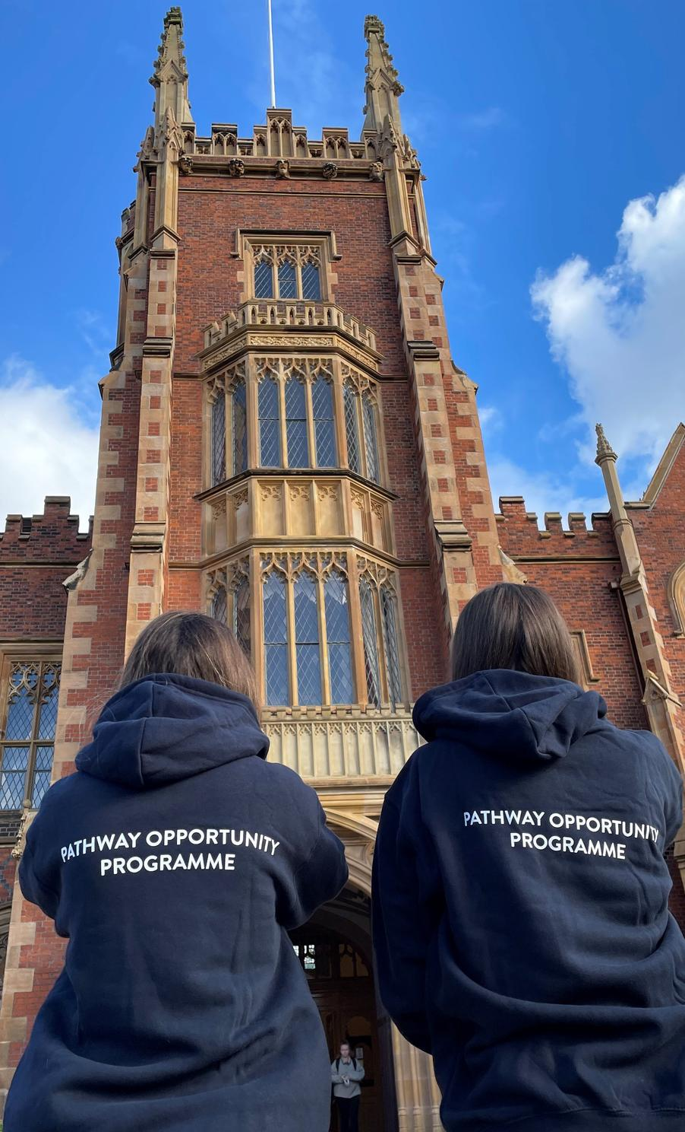

APPLICATION CHECKLIST
Review the eligibility requirements (Section A and Section B) for the programme.
Check the Postcode Checker on the Pathway website at the ‘Media’ tab.
Research the courses on your preferred Pathway to ensure you meet the entry requirements of one of the courses on that Pathway.
Ask a teacher to complete a reference for you.
Review the online application form and prepare your information and statements.
Complete the online application in one sitting (as it cannot be saved mid-progress) and submit application.
Notes:
“The web link takes you to this web page. The first part is the instructions in the red part. Please read all of these before applying and have all the information you need
To check your postcode, download the Postcode Checker 2026 in the Media Section of the web site and use Ctrl+F to search for your postcode (with the space in the middle). If it says “Meets Postcode Criteria” then they meet the Postcode criteria in Section B. If it says “Does not meet Criteria” then they don’t meet it. You can still apply however particularly if you meet other criteria in section B
Then tell them to apply by clicking the “THE ONLINE APPLICATION IS AVAILABLE HERE!”.
20

Slide 19

Do you...
APPLY NOW!
  Want to study at Queen’s University Belfast?
  Meet the eligibility criteria (Section A and one from Section B)?
  Want to receive a Guaranteed Conditional Offer / Interview to Queen’s?
  Want an opportunity to receive up to a 2 grade reduction in your offer?
  Want a £1000 bursary from Kilwaughter Minerals in your first year?
  Experience university life, make new friends, and enjoy some challenges?
APPLY NOW!
Notes:
Read out each point and
Click
Then apply now – applications open on 30th September 2024
Click
22

Slide 20
QUESTIONS?
Go online:
go.qub.ac.uk/QUBPathway
Telephone: 028 9097 5020
Email: pop@qub.ac.uk
Notes:
Any Questions.
24

